Slide 1
Linear Regression
With Python 3.11 and Sage 8.9 [or somesuch]
Made by Gal Lebel and Alex Baucke on May 26th, 2023

Slide 2
> Contents
Problem Statement
Deriving a Solution
What / why are we approximating?
Definitions
The error function
Via calculus
Via matrix/vector multiplication
Geometric implications
Example
Other Aspects
Obtain a line through 3 points
Verify the solution
Further examples
Pyplot and stylesheets
Notes:
2 mins

Slide 3
Problem Statement

Slide 4
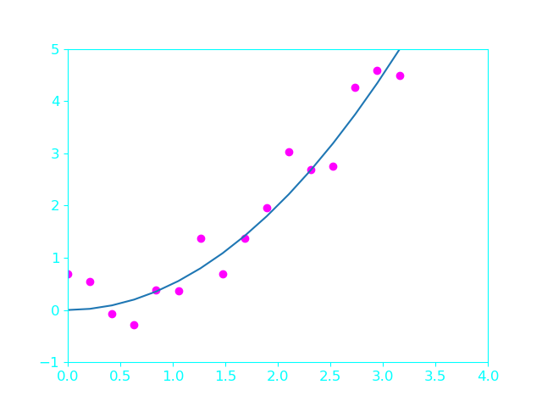
Problem Statement (1/3) - Finding the perfect fit
Given n points of data: Pᵢ := (xᵢ, yᵢ) 0 … i … n
Find a function that best reflects the data.
The naive idea:
Find an f (x), such that f (xᵢ) = yᵢ
=> This is interpolation
Why is interpolation a terrible idea for this?
Seen on this graph: The stem function (blue) with errors on the y values added to equally spaced points (purple)
=> The purple dots are our Pᵢ
Notes:
4

Slide 5
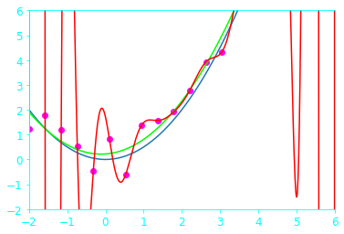
Problem Statement (2/3) - Interpolation vs. Approximation
Let’s assume a sample size of 20 (or 20k…?)
=> #P = 20 and deg(f (x)) = 19
Interpolation will not work here:
Numerical stability
Performance
Usefulness for prediction
“Model mismatch”
This also means that there cannot be a perfect solution - an approximation is needed.
So we are looking for f̂ (x) ∈ P_{m}⊂ P_{n} , with P_{n} denoting the polynomials of degree <= n
Notes:
7

Slide 6
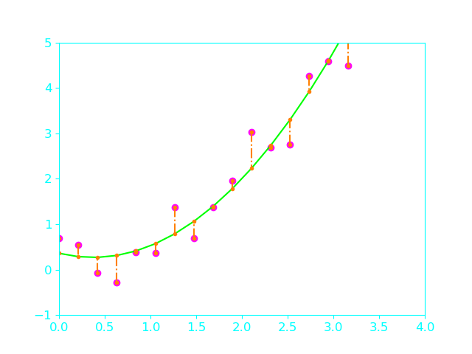
Problem Statement (3/3) - Finding the imperfect fit
We need a measure of “quality” for the approx.
This usually means a function like this:
Err( f, P ) = ∑_{i..n} (y_{i} - f (x_{i}) )² (x_{i}, y_{i}) ∈ Pᵢ
Therefore, we can write:
f̂ := argmin _{f ∈ Pm} ( Err( f, P ) )
for our approximation space P_{m}
And call f̂ ∈ P_{m} the Least Squares Approximation of P
Notes:
10

Slide 7
Problem Statement - Recap
Interpolating the stem function in every P_{1…n} with f(x) ∈ P_{n} is not feasible
Instead, we look for a “good” approximation with f(x) ∈ P_{m} where m << n
This means that we will have to allow some “error”: Err( f, P)
Finding the f̂(x) ∈ P_{m} that minimizes this error is our solution.
Such an f̂(x) could look like this: f̂(x) = c₀ + c₁ x f̂(x) ∈ P₁
( If written in the monomial basis )
The next chapters are about how to obtain these c_{i} !
Notes:
12

Slide 8
Deriving a Solution

Slide 9
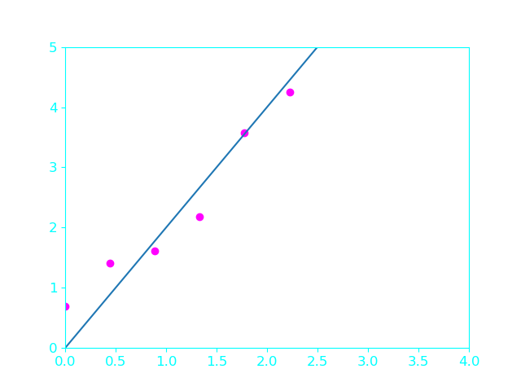
The Calculus Way (1/5)
We know that a solution to our problem takes the form:
f̂(x)=c₀+c₁x+c₂x²+... , f̂(x) ∈ P_{m} , m < n
For simplicity, we assume m = 2 , so f̂ ∈ P₂ is linear.
Given n data points and c₀, c₁ as our unknowns, we have
c₀ + c₁x₁ = y₁
….
c₀ + c₁x_{n} = y_{n}
This system of n > 2 equations and 2 unknowns is overdetermined and has no exact solution.
The blue line is the assumed linear relation. The points deviate by some noise from the line.
Notes:
A system of equation is overdetermined when we have more equations than unknowns, so even by gaussian elimination we won’t be able to arrive to a solution (but it is not always the case)

Slide 10
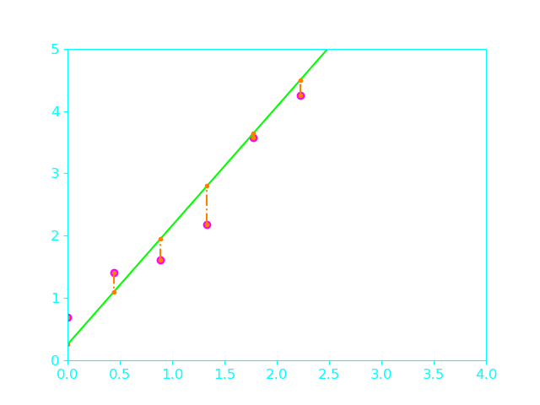
The Calculus Way (2/5)
To make solving the system possible, we introduce residuals r_{i} given by:
r_{i} := y_{i}- f(x_{i}) = y_{i} - (c₀+c₁x_{i})
By allowing errors into our approximation, we have turned our problem into a system of n equations and n unknowns, thus the system has an exact solution!
We also want to square and sum the residuals:
S(c₀, c₁) = r₁²+r₂²+...+r_{m}² = (y_{i}-(c₀+c₁x_{i}))² + … = Err( f, P )
Green line is a possible imperfect fit line. The residuals are colored orange.
Notes:
Why do we square up the residuals ? We want to treat points below our approximating line (a negative residual) the same as a positive one.
Squaring and summing is also a way to assess the quality of the approximation : big residuals will have big contribution to higher error score than small ones.

Slide 11
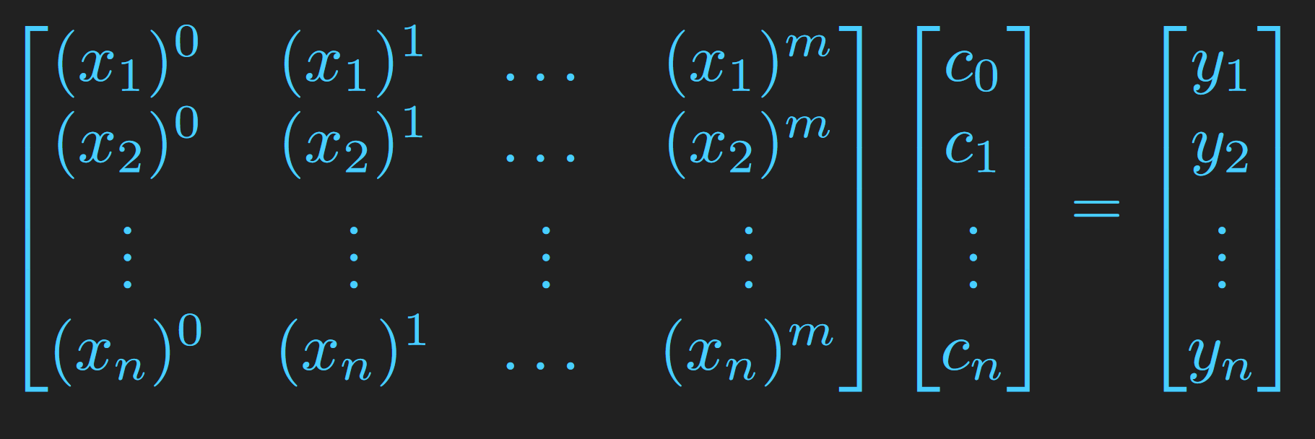
The Matrix Way (3/5)
How do we minimize the error function S?
Lets make our life easier with some matrices, assuming a system of equations of the form
Ax = b
A is a n x m Matrix, where the columns vectors are the monomial basis of the space P_{m}
x is a N x 1 vector of our coefficients which we want to determine
b is a Nx1 vector of the n observation points (the y_{i}’s)
A (tall-matrix : M < N) x b
Dimensions: NxM N N
Where are the residuals?
Aren’t we looking for an approximation?
Notes:
Show once again, that since we have NxM * Nx1 we cannot solve this system.

Slide 12
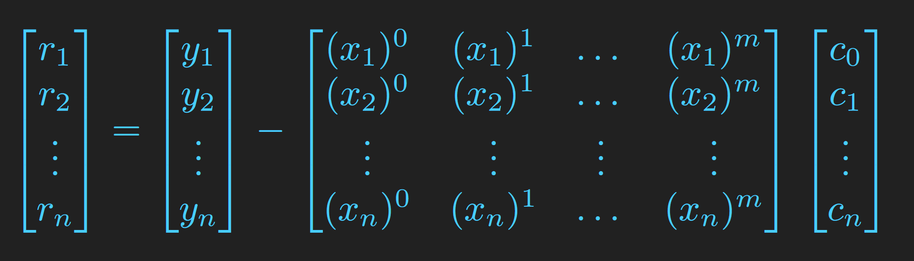
The Matrix Way (4/5)
Considering our residuals from earlier, we allow for some error, thus we have:
Ax + r = b → r_{i} = b_{i} - A_{i}x_{i}
And with error function S:
S(x^{T}) = r₁² + … r_{n}² = r^{T}r = (b - Ax)^{T} (b - Ax)
(we have here x as argument since its the coefficients vector)
And through simplification of the right-hand-side:
S(x) = b^{T}b - 2x^{T}A^{T}b + x^{T}A^{T}Ax

Slide 13
The Matrix Way (5/5)
Since we’re interested in the solution for x, we will derive S(x) w.r.t. x and set it to 0:
∂S(x)\მx = 0 = -2A^{T}b + 2A^{T}Ax
Divide by 2 : = -A^{T}b + A^{T}Ax
Isolate x : → A^{T}Ax = A^{T}b
Multiply by (A^{T}A)⁻¹ : → x = (A^{T}A)⁻¹A^{T}b
Thus we have arrived at the matrix form of the solution!
S(x) = b^{T}b - 2x^{T}A^{T}b + A^{T}x^{T}Ax
∂S(x)\მx b^{T}b = 0
∂S(x)\მx -2x^{T}A^{T}b is just like ∂S(x)\მx 2x*y with y = A^{T}b → = -2A^{T}b
∂S(x)\მx A^{T}x^{T}Ax = ∂S(x)\მx x²A^{T}A = 2A^{T}Ax
Equivalently, we could have arrived to this by
Ax = b (multiply by A^{T})
A^{T}Ax = A^{T}b (assuming |A^{T}A| != 0, multiply by (A^{T}A)⁻¹, otherwise - no solution!)
x = (A^{T}A)⁻¹A^{T}b
Which is exactly what we’ve on the left side!

Slide 14
Geometrical Visualization \ Solution (1/2)
b
Col(A) spans a plane in 3D space
b ∈ R³ ∧ b ∉ col(A)
A solution would be to get as close to the vector b while staying in the subspace col(A).
The shortest distance from b to col(A) would be an orthogonal vector going from b down to a specific point (call it b_{col(A)} ) in col(A).
b_{col(A)} = b - Ax
p ∈ col(A)
b_{col(A)}
A₁
A₂
A1 and A2 are the columns of A - so just 2 columns (for simplicity of visualization)

Slide 15
Geometrical Visualization \ Solution (2/2)
b
Two identities:
(b - Ab_{col(A)})⋅(Ab_{col(A)}-Ap) = 0
||(b - Ab_{col(A)})|| <= ||(b - Ap)||
Implies that there is one exact solution that yields the best approximation under the given circumstances.
We want a linear combination of the column vectors of A to be as close to b (which means it should be equal to b_{col(A)}).
By orthogonality we have: (b - Ax)A_{i} = 0 for every column A_{i} in A. (note that b and Ax are both Nx1 vectors)
So we have (b - Ax)A_{i} = (b-Ax)^{T}A.
Then :
(b - Ax)^{T}A = b^{T}A - A^{T}Ax
→ b^{T}A = A^{T}Ax
→ x = (A^{T}A)⁻¹b^{T}A
b_{col(A)} = b - Ax
p ∈ col(A)
b_{col(A)}
A₁
A₂
A1 and A2 are the columns of A - so just 2 columns (for simplicity of visualization)

Slide 16
Deriving a solution - Recap
By orienting ourselves to the premise of the problem statement - we’ve derived a solution.
We have shown two different ways (geometry and calculus with some matrices) to reach the same solution!
So what about a short example, to understand and see how this actually works?
The next short chapter will show a very simple example
That demonstrates what’ve shown so far.

Slide 17
A simple example for approximating 3 points

Slide 18
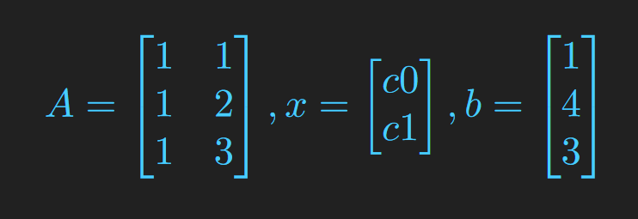
A simple example for approximating 3 points
Given 3 points of data
(1,1), (2,4), (3,3)
We want to find the line with the best fit.
We will create:
the matrix A with the monomial basis (x_{i}⁰ , x_{i}¹)
the vector x with the coefficients c₀, c₁
the vector b with the y points
The 3 matrices for our system of equations

Slide 19
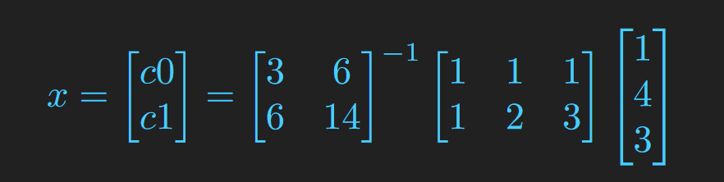
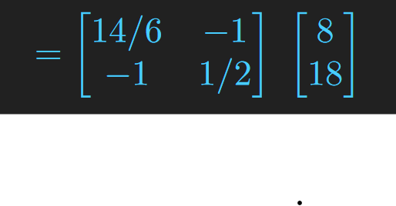
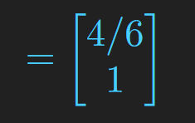
A simple example for approximating 3 points
We can now use our derived solution for the matrix form: x = (A^{T}A)⁻¹A^{T}b
And we get:

Slide 20
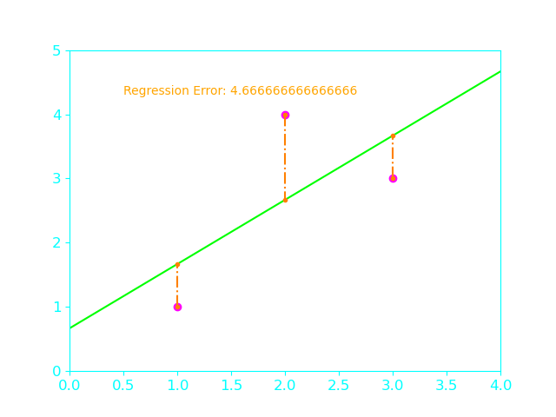
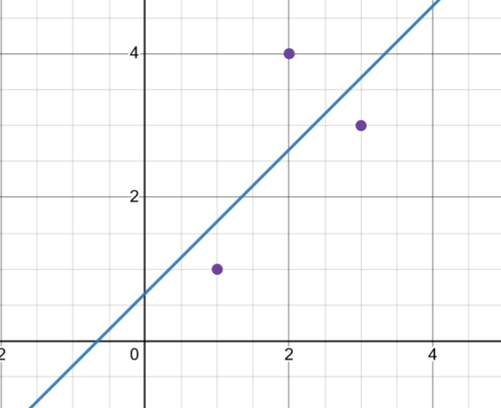

A simple example for approximating 3 points
We can verify this calculation with both desmos and our program
c0 = 0.66666667 c1 = 1
Our Program Desmos

Slide 21
Other Aspects

Slide 22
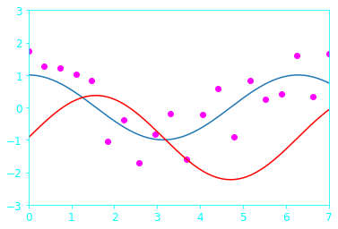
Limitation of estimating with linear least squares
As the name suggests, linear least squares is best for approximating linear relationships between dependent and independent set of datas.
Assume data with the form: f(x) = c₀ * sin(x) (with some noise added). As we know, the sine function is nonlinear, but the function overall is linear with with respect to c₀. For this function, c₀ will be adjusting the amplitude of the sine curve, i.e. - if sin(x) goes from 0 to 1, f(x) will oscillate from -c₀ to c₀.
sin(x + c₀) - the stem function
a + b * sin(x) - approximation function

Slide 23

Other types of estimation methods
Among the linear least squares, there are more estimation methods with the same goal.
The total least squares is one of them.
The usual assumption for TLS is, that the error that arises through the measurement of the data is equal in both the dependant and independent variables, thus an approximation of the residuals by the distance from the tangent of the line\curve is favoured and more robust to those noises\errors, in comparison to the linear least squares.
Notes:
Mention that the linear least squares assumes a noise only in the dependant variables, whereas the total one assumes noise in both independent & dependant variables

Slide 24
Ty for your time 🤡
Any Questions?
Resources for further reading:
https://en.wikipedia.org/wiki/Linear_least_squares
https://textbooks.math.gatech.edu/ila/1553/least-squares.html
https://en.wikipedia.org/wiki/Gram_matrix
https://jakevdp.github.io/PythonDataScienceHandbook/04.11-settings-and-stylesheets.html

